Slide 1
Convolutional Neural Network – III
Optimization
Lecture 4
Part 3
Generative AI for Computer Vision

Slide 2
Content
Deeper network is not always good
Problems of Deeper Network
Vanishing Gradient (VG) Problem
Activation Functions and VG Problem
Problems with Activation Functions

Slide 3
Deeper Nets vs Shallower Nets
Deep neural networks (deeper nets) contain many hidden layers, allowing them to learn complex patterns and hierarchical features from data.
They are widely used in tasks such as image recognition, natural language processing, and speech recognition because they can achieve high accuracy when trained with large datasets.
However, deeper networks require more computational resources, longer training times, and careful techniques to avoid problems such as overfitting or vanishing gradients.
In contrast, shallow neural networks (shallower nets) have only one or a few hidden layers.
They are simpler, faster to train, and require less computational power, making them suitable for smaller datasets and less complex tasks.
Although shallow networks are easier to implement and interpret, they may struggle to capture intricate relationships in data that deeper networks can learn effectively.
The choice between deeper and shallower networks depends on the complexity of the problem, the amount of available data, and the computational resources.

Slide 4
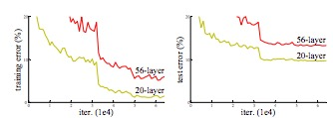
Deeper is not always better
In principle, adding more layers increases the network's capacity, enabling it to learn more complex and hierarchical feature representations.
However, this greater capacity also raises the risk of overfitting, particularly when training data are limited.
Also, in practice, very deep networks often experience optimization challenges that prevent them from fully utilizing their theoretical capacity.
CIFAR-10
Source: He, Zhang, Ren, and Sun (2015)

Slide 5
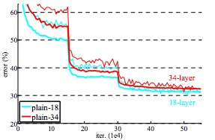
Deeper is not always better
As depth increases, the credit-assignment problem becomes more severe, making it difficult for gradients to propagate effectively through many layers during backpropagation.
This can lead to optimization degradation, where deeper models achieve higher training error than their initial counterparts despite having greater expressive power.
Consequently, simply increasing network depth does not guarantee improved performance; effective architectural designs, such as residual connections, normalization techniques, and appropriate optimization strategies, are often required to train deep networks successfully.
ImageNet
thin=train,
thick=valid.
Source: He, Zhang, Ren, and Sun (2015)

Slide 6

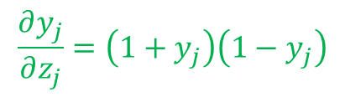

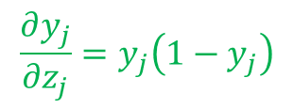
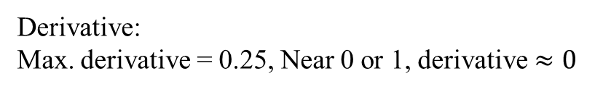
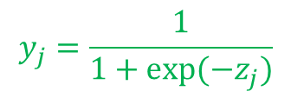

The vanishing gradient problem
The vanishing gradient problem is a fundamental optimization challenge encountered when training deep neural networks using gradient-based learning algorithms such as backpropagation.
During backpropagation, gradients are computed by repeatedly applying the chain rule through multiple layers.
When activation functions such as the sigmoid or hyperbolic tangent (tanh) have derivatives less than one, the repeated multiplication of these small derivatives causes the gradients to decrease exponentially as they propagate toward the earlier layers.
For Sigmoid Activation Function
$$y_{j}=\frac{1}{1+exp⁡(−z_{j})}$$
$$\frac{∂y_{j}}{∂z_{j}}=y_{j}\left(1−y_{j}\right)$$
Derivative:
Max. derivative = 0.25, Near 0 or 1, derivative $≈0$
0.25
$$S′\left(Z\right)$$
-4
-2
-1
0
1
2
4
$$Z$$
For Hyperbolic tangent (tanh) Function
$$y_{j}=\tanh\left(z_{j}\right)$$
$$\frac{∂y_{j}}{∂z_{j}}=\left(1+y_{j}\right)\left(1−y_{j}\right)$$

Slide 7
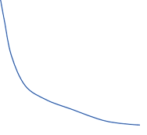
The vanishing gradient problem
As a result, the weights in initial layers receive extremely small updates, significantly slowing or even preventing learning.
This limits the network's ability to capture long-range dependencies and learn effective low-level feature representations, leading to poor convergence and suboptimal training performance.
Although deeper networks theoretically possess greater representational capacity (expressive ability), the vanishing gradient problem makes them difficult to optimize in practice.
Modern deep learning architectures mitigate this issue through techniques such as Rectified Linear Unit (ReLU) activations, residual (skip) connections, batch normalization, careful weight initialization (e.g., Xavier or He initialization), and adaptive optimization algorithms, all of which facilitate more effective gradient propagation and stable training.
Gradient
n . . . . 3 2 1
Layer

Slide 8



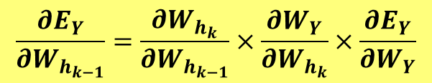














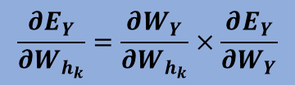













Backpropagation : Algorithm
$$W_{h_{1}}$$
$$h_{1}$$
$$h_{11}$$
$$h_{1e}$$
$$h_{1n}$$
$$W_{h_{2}}$$
$$\frac{∂E_{Y}}{∂W_{h_{1}}}=\frac{∂W_{h_{2}}}{∂W_{h_{1}}}×\frac{∂W_{h_{3}}}{∂W_{h_{2}}}×…×\frac{∂W_{h_{k}}}{∂W_{h_{k−1}}}×\frac{∂W_{Y}}{∂W_{h_{k}}}×\frac{∂E_{Y}}{∂W_{Y}}$$
$$h_{2}$$
$$h_{21}$$
$$h_{2e}$$
$$h_{2n}$$
$$W_{h_{3}}$$
$$\frac{∂E_{Y}}{∂W_{h_{2}}}=\frac{∂W_{h_{3}}}{∂W_{h_{2}}}×…×\frac{∂W_{h_{k}}}{∂W_{h_{k−1}}}×\frac{∂W_{Y}}{∂W_{h_{k}}}×\frac{∂E_{Y}}{∂W_{Y}}$$
$$W_{h_{k−1}}$$
$$h_{k−1}$$
$$h_{k−11}$$
$$h_{k−1e}$$
$$h_{k−1n}$$
$$\frac{∂E_{Y}}{∂W_{h_{k−1}}}=\frac{∂W_{h_{k}}}{∂W_{h_{k−1}}}×\frac{∂W_{Y}}{∂W_{h_{k}}}×\frac{∂E_{Y}}{∂W_{Y}}$$
$$W_{h_{k}}$$
$$h_{k}$$
$$h_{k1}$$
$$h_{ke}$$
$$h_{kn}$$
$$\frac{∂E_{Y}}{∂W_{h_{k}}}=\frac{∂W_{Y}}{∂W_{h_{k}}}×\frac{∂E_{Y}}{∂W_{Y}}$$
$$W_{Y}$$
$$w_{ei}^{k−1}(t+1)=w_{ei}^{k−1}\left(t\right)−η\frac{∂E_{Y}}{∂h_{k−1}}$$
$$Y_{1}$$
$$Y_{2}$$
$$Y_{p}$$
$$E=\frac{1}{2}{(D−d)}^{2}$$
$$\frac{∂E_{Y}}{∂W_{Y}}$$
Weight Updation in a Backward direction (Backpropagation) using chain rule

Slide 9





















Vanishing Gradient Concept
$$W_{h_{1}}$$
$$h_{1}$$
$$h_{11}$$
$$h_{1i}$$
$$h_{1n}$$
$$W_{h_{2}}$$
$$h_{2}$$
$$h_{21}$$
$$h_{2i}$$
$$h_{2n}$$
$$W_{h_{3}}$$
$$h_{3}$$
$$h_{31}$$
$$h_{3i}$$
$$h_{3n}$$
$$W_{Y}$$
$$Y_{1}$$
$$Y_{2}$$
$$Y_{p}$$
$$E_{Y}=\frac{1}{2}{(D−d)}^{2}$$
$$\frac{∂E_{Y}}{∂W_{Y}}$$

Slide 10
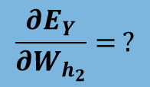
Vanishing Gradient Concept
$$W_{h_{1}}$$
$$h_{1}$$
$$h_{11}$$
$$h_{1i}$$
$$h_{1n}$$
$$\frac{∂E_{Y}}{∂W_{h_{2}}}= ?$$
$$W_{h_{2}}$$
$$h_{2}$$
$$h_{21}$$
$$h_{2i}$$
$$h_{2n}$$
$$W_{h_{3}}$$
$$h_{3}$$
$$h_{31}$$
$$h_{3i}$$
$$h_{3n}$$
$$W_{Y}$$
$$Y_{1}$$
$$Y_{2}$$
$$Y_{p}$$
$$E_{Y}=\frac{1}{2}{(D−d)}^{2}$$
$$\frac{∂E_{Y}}{∂W_{Y}}$$

Slide 11

Vanishing Gradient Concept
$$W_{h_{1}}$$
$$h_{1}$$
$$h_{11}$$
$$h_{1i}$$
$$h_{1n}$$
$$W_{h_{2}}$$
$$\frac{∂E_{Y}}{∂W_{h1}}=\frac{∂E_{h_{2} }}{∂W_{h1}}×\frac{∂E_{Y}}{∂W_{h2}}$$
Chain Rule !!
$$h_{2}$$
$$h_{21}$$
$$h_{2i}$$
$$h_{2n}$$
$$W_{h_{3}}$$
$$h_{3}$$
$$h_{31}$$
$$h_{3i}$$
$$h_{3n}$$
$$W_{Y}$$
$$Y_{1}$$
$$Y_{2}$$
$$Y_{p}$$
$$E_{Y}=\frac{1}{2}{(D−d)}^{2}$$
$$\frac{∂E_{Y}}{∂W_{Y}}$$

Slide 12

Vanishing Gradient Concept
$$W_{h_{1}}$$
$$h_{1}$$
$$h_{11}$$
$$h_{1i}$$
$$h_{1n}$$
$$W_{h_{2}}$$
$$h_{2}$$
$$h_{21}$$
$$h_{2i}$$
$$h_{2n}$$
$$W_{h_{3}}$$
$$h_{3}$$
$$\frac{∂E_{Y}}{∂W_{h1}}=\frac{∂E_{h_{2} }}{∂W_{h_{1}}}×\frac{∂E_{h_{3}}}{∂W_{h_{2}}}×\frac{∂E_{Y}}{∂W_{h_{3}}}$$
$$h_{31}$$
$$h_{3i}$$
$$h_{3n}$$
Chain Rule !!
$$W_{Y}$$
$$Y_{1}$$
$$Y_{2}$$
$$Y_{p}$$
$$E_{Y}=\frac{1}{2}{(D−d)}^{2}$$
$$\frac{∂E_{Y}}{∂W_{Y}}$$

Slide 13






















Vanishing Gradient Concept
$$W_{h_{1}}$$
$$h_{1}$$
$$h_{11}$$
$$h_{1i}$$
$$h_{1n}$$
$$W_{h_{2}}$$
$$h_{2}$$
$$h_{21}$$
$$h_{2i}$$
$$h_{2n}$$
$$W_{h_{3}}$$
$$h_{3}$$
$$h_{31}$$
$$h_{3i}$$
$$h_{3n}$$
$$W_{Y}$$
$$\frac{∂E_{Y}}{∂W_{h1}}=\frac{∂E_{h_{2} }}{∂W_{h_{1}}}×\frac{∂E_{h_{3}}}{∂W_{h_{2}}}×\frac{∂E_{Y}}{∂W_{h_{3}}}×\frac{∂E_{Y}}{∂W_{Y}}$$
$$Y_{1}$$
$$Y_{2}$$
$$Y_{p}$$
Chain Rule !!
$$E_{Y}=\frac{1}{2}{(D−d)}^{2}$$
$$\frac{∂E_{Y}}{∂W_{Y}}$$

Slide 14






















Vanishing Gradient Concept
$$W_{h_{1}}$$
Vanishing Gradient Problem
  When these derivatives are small, the gradient signal progressively diminishes as it is back-propagated through the network.
$$h_{1}$$
$$h_{11}$$
$$h_{1i}$$
$$h_{1n}$$
$$W_{h_{2}}$$
$$h_{2}$$
$$h_{21}$$
$$h_{2i}$$
$$h_{2n}$$
$$W_{h_{3}}$$
What happens if the derivatives are small?
$$h_{3}$$
$$h_{31}$$
$$h_{3i}$$
$$h_{3n}$$
$$W_{Y}$$
$$Y_{1}$$
$$Y_{2}$$
$$Y_{p}$$
$$\frac{∂E_{Y}}{∂W_{h1}}=\frac{∂E_{h_{2} }}{∂W_{h_{1}}} ×\frac{∂E_{h_{3}}}{∂W_{h_{2}}}× \frac{∂E_{Y}}{∂W_{h_{3}}}×\frac{∂E_{Y}}{∂W_{Y}}$$
$$E_{Y}=\frac{1}{2}{(D−d)}^{2}$$
$$\frac{∂E_{Y}}{∂W_{Y}}$$

Slide 15





















Why vanishing gradient is a problem ?
$$W_{h_{1}}$$
During backpropagation, gradients are strong near the output layer but become progressively smaller toward the input layer due to repeated multiplication by values less than 1 (chain rule).
As the gradient decays during backpropagation, weight updates in the early layers become negligible. As a result, learning slows down or may stop altogether. This is known as the vanishing gradient problem.
$$h_{1}$$
$$h_{11}$$
$$h_{1i}$$
$$h_{1n}$$
$$W_{h_{2}}$$
$$h_{2}$$
$$h_{21}$$
$$h_{2i}$$
$$h_{2n}$$
$$E_{2}$$
$$W_{h_{3}}$$
$$h_{3}$$
$$h_{31}$$
$$h_{3i}$$
$$h_{3n}$$
$$W_{Y}$$
$$Y_{1}$$
$$Y_{2}$$
$$Y_{p}$$
$$E_{Y}=\frac{1}{2}{(D−d)}^{2}$$
$$\frac{∂E_{Y}}{∂W_{Y}}$$

Slide 16





Activation Functions
1
tanh(Z)
1
$$S\left(Z\right)= \frac{1}{1+e^{−Z}}$$
Z
0.5
-$∞$
0
+$∞$
Z
-$∞$
0
+$∞$
Sigmoid Function
-1
Tanh Function
max (0.1Z,Z)
max (0,Z)
z
z
ReLU Function
Leaky ReLU Function

Slide 17
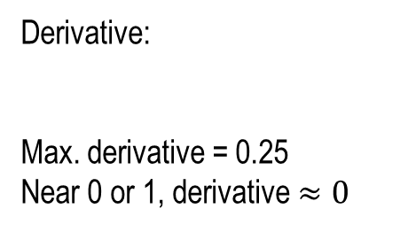




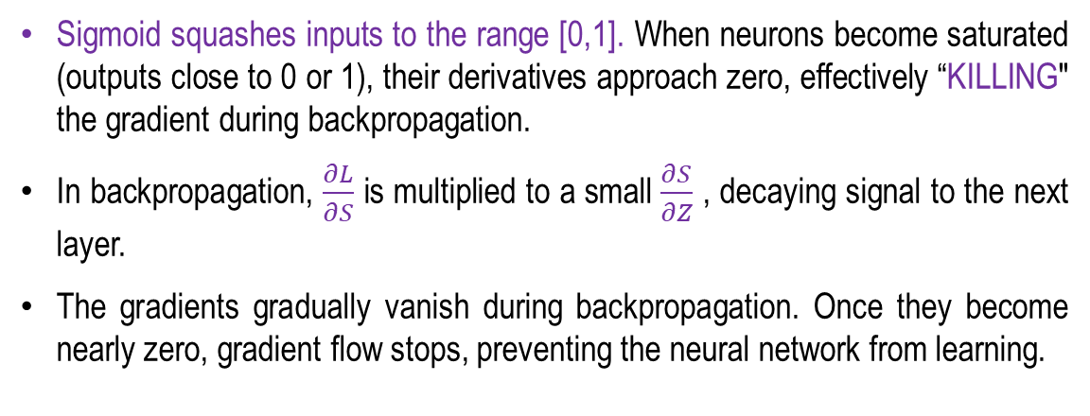

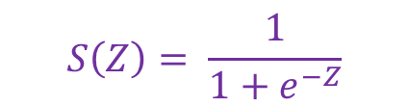




Vanishing Gradient Problem
Problem with Sigmoid Activation Function
Sigmoid squashes inputs to the range [0,1]. When neurons become saturated (outputs close to 0 or 1), their derivatives approach zero, effectively “KILLING" the gradient during backpropagation.
In backpropagation, $\frac{∂L}{∂S}$ is multiplied to a small $\frac{∂S}{∂Z}$ , decaying signal to the next layer.
The gradients gradually vanish during backpropagation. Once they become nearly zero, gradient flow stops, preventing the neural network from learning.
1
$$S\left(Z\right)= \frac{1}{1+e^{−Z}}$$
0.5
Z
-$∞$
0
+$∞$
Sigmoid Function
$$S\left(Z\right)= \frac{1}{1+e^{−Z}}$$
0.25
$$S′\left(Z\right)$$
$$Z$$
-4
-2
-1
0
1
2
4
$$Z$$
Sigmoid
Function
Derivative:
Max. derivative = 0.25
Near 0 or 1, derivative $≈0$
$$S^{′}\left(Z\right)=\frac{∂S}{∂Z}=S\left(Z\right)[1−S\left(Z\right)]$$
$$\frac{∂L}{∂Z}=\frac{∂L}{∂S}\frac{∂S}{∂Z}$$
$$\frac{∂L}{∂S}$$

Slide 18
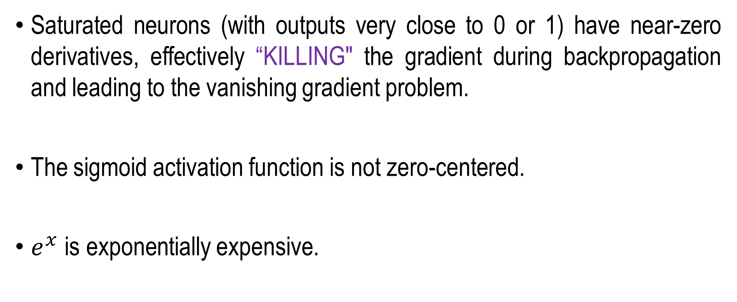
Vanishing Gradient Problem
Problem with Sigmoid Activation Function
Saturated neurons (with outputs very close to 0 or 1) have near-zero derivatives, effectively “KILLING" the gradient during backpropagation and leading to the vanishing gradient problem.
The sigmoid activation function is not zero-centered.
$e^{x}$ is exponentially expensive.

Slide 19

Vanishing Gradient Problem
Problem with tanh Function
Squashes numbers to range [-1 1].
Zero centred.
  Better than the Sigmoid
Still kill gradients
  Causes Vanishing Gradient
“tanh” is just scaled version of the “Sigmoid”.
1
tanh(Z)
Z
-$∞$
0
+$∞$
-1
Tanh Function
$$\frac{∂}{∂Z}\tanh\left(Z\right)={Sech}^{2}(Z)$$
Z
-4
-2
-1
0
1
2
4
Derivative of Tanh Function

Slide 20


Vanishing Gradient Problem
Rectified Linear Unit (ReLU) Activation Function
Does not saturate in positive region
Computationally efficient
Converges faster than sigmoid and tanh
Dying ReLU Problem: If a neuron's weights are updated such that its input is always negative, the ReLU output remains 0. Since the gradient is also 0, the neuron stops updating its weights, effectively "dies," and no longer contributes to the learning process.
Better than sigmoid & tanh
$$\frac{∂}{∂Z}\max\left(0,Z\right)=0 if Z<0$$
max (0,Z)
$$\frac{∂}{∂Z}\max\left(0,Z\right)=1 if Z>0$$
z
ReLU Function

Slide 21


Vanishing Gradient Problem
Leaky Rectified Linear Unit (ReLU) Activation Function
The value 0.1 is arbitrary; α in max⁡(αz,z) can be any small positive constant.
Solves ReLU’s dying neuron problem.
  Avoid 0 gradient by introducing a small slope.
Does not suffer from saturation.
Computationally efficient.
Typically converges faster than sigmoid and tanh in practice.
$$\frac{∂}{∂Z}\max{(αZ,Z)}=α if Z<0$$
max (0.1Z,Z)
z
$$\frac{∂}{∂Z}\max\left(αZ,Z\right)=1 if Z>0$$
Leaky ReLU Function

Slide 22
Activation Function are not enough to handle Vanishing Gradient Problem Completely
Leaky ReLU reduces but does not eliminate the vanishing gradient problem. For negative inputs, its gradient is small but non-zero (typically α < 1). During backpropagation through many layers, these gradients are repeatedly multiplied, causing them to decay exponentially. As a result, very deep networks can still experience vanishing gradients, although the effect is less severe than with standard ReLU, sigmoid, or tanh.
Why Leaky ReLU Does Not Completely Solve the Vanishing Gradient Problem
  Small Negative Gradient: For negative inputs, Leaky ReLU uses a small slope α (e.g., 0.01). Although the gradient is non-zero, it is still less than 1, so repeated multiplication across many layers causes gradients to shrink.
  Primarily Addresses Dying ReLU: Leaky ReLU is designed to prevent neurons from becoming permanently inactive ("dying ReLU"), not to completely eliminate vanishing gradients in very deep networks.
  Cumulative Gradient Decay: Even without zero gradients, repeatedly multiplying gradients smaller than 1 during backpropagation causes them to decay exponentially, making training of very deep networks difficult.
To effectively address the vanishing gradient problem in very deep networks, architectures such as Residual Networks (ResNets) use residual (skip) connections that allow gradients to bypass one or more layers, preserving gradient flow and enabling the successful training of much deeper models.

Slide 23
Summary
Deeper network is not always good
Problems of Deeper Network
Vanishing Gradient (VG) Problem
Activation Functions and VG Problem
Problems with Activation Functions

Slide 24
Residual Network
Next
Lecture 5: Part 1
Generative AI for Computer Vision

Slide 25
Deeper Nets vs Shallower Nets
A deeper network can represent any function that a shallower network can.
  Use identity mappings for the additional layers
Greater depth increases model capacity, making overfitting more likely in theory.
However, optimization becomes more difficult, so deeper networks often underfit the training set.
  Degradation due to harder credit-assignment problem
  Deeper isn’t always better!
CIFAR-10
Identity Mapping
ImageNet
thin=train,
thick=valid.
Source: He, Zhang, Ren, and Sun (2015)

Slide 26
Deeper Networks are not always better
Problems
  Vanishing / exploding gradients
  Internal Covariate Shift
  Overfitting
  Computation cost
Solutions:
  Choosing proper activation function
  Batch Normalization
  Parameter Initialization
  Dropout
  Weight Sharing
  Data Augmentation

Slide 27
Why Deeper Networks fail ?
Credit Assignment Problem
  The Credit Assignment problem is the challenge of determining which neurons or connections (weights) are responsible for an overall error or reward.
  The problem becomes more difficult when feedback is delayed or distributed across many layers, making it hard to identify which internal computations should be adjusted.
  How can a Layer 2 neuron know what its output should be until the higher layers produce accurate outputs?
  Similarly, how can a Layer 4 neuron determine its correct output until the preceding layers learn the appropriate feature representations?

Slide 28
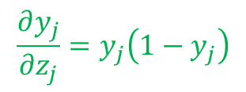
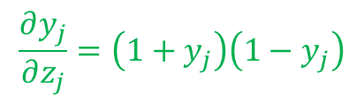
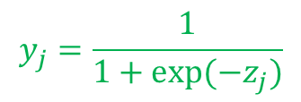

Why Deeply Layered Networks Failed
Vanishing Gradient Problem
  Sigmoid and tanh squash inputs into a small range, and their derivatives are typically less than 1.
  During backpropagation, gradients are repeatedly multiplied across many layers, causing them to shrink exponentially.
  As a result, the early layers receive very small gradients, learn very slowly, and this is known as the vanishing gradient problem.
$$y_{j}=\frac{1}{1+exp⁡(−z_{j})}$$
$$\frac{∂y_{j}}{∂z_{j}}=y_{j}\left(1−y_{j}\right)$$
$$y_{j}=\tanh\left(z_{j}\right)$$
$$\frac{∂y_{j}}{∂z_{j}}=\left(1+y_{j}\right)\left(1−y_{j}\right)$$
Gradient
n . . . . 3 2 1
Layer

Slide 29




Feature Learning at Different Hidden Layers
Pixels
Input
First Hidden Layer
Edges
Second Hidden Layer
Strokes
Third Hidden Layer
Letters
Fourth Hidden Layer
Word
Vision Hierarchy for recognizing handwritten text

Slide 30



Feature Learning at Different Hidden Layers
Pixels
Input
First Hidden Layer
Edges
Second Hidden Layer
Object Parts
Third Hidden Layer
Objects
Vision Hierarchy for elephant recognition
Image Source : https://miro.medium.com/v2/resize:fit:640/format:webp/0*COtl04hiK9wvUgs6

